Slide 1

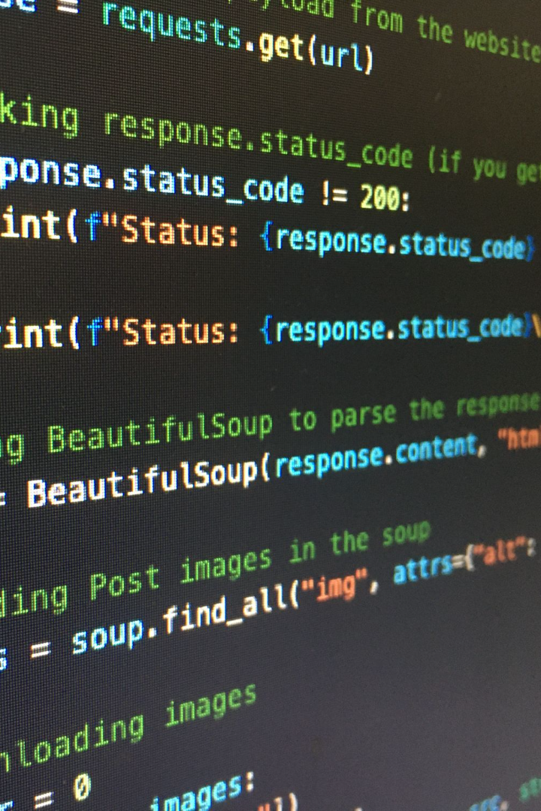

Exploring the Power of Strings 💪
Get ready to dive into the exciting world of Python strings. We'll explore everything from basic operations to advanced methods. Let's get started!
by Anik Acharjee

Slide 2
String Literals in Python
Single and Double Quotes
Triple Quotes
Escape Characters
Triple quotes are used for multiline strings and docstrings. For example: """Python is a powerful programming language. It is widely used for data analysis and machine learning."""
Escape characters are used to represent special characters. For example, \n represents a new line and \\ represents a backslash.
Python strings can be represented using single or double quotes. For example: 'Hello, World!' or "Goodbye, Universe!"

Slide 3
Basic Operations with Strings
Repetition
Use the * operator to repeat a string a certain number of times. For example, "Python " * 3 gives "Python Python Python".
1
2
3
Concatenation
Length
Use the + operator to concatenate two or more strings. For example, "Hello" + "World" gives "HelloWorld".
Use the len() function to get the length of a string. For example, len("Hello, World!") gives 13.

Slide 4

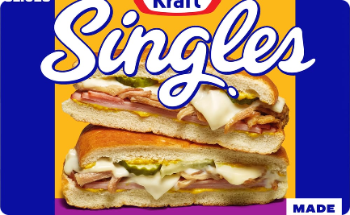
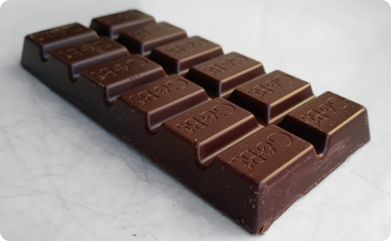
String Slices and Indexing
Indexing
Slicing
Step
You can access individual characters in a string using indexing. For example, "Hello"[1] gives "e".
You can extract a portion of a string using slicing. For example, "Hello, World!"[7:12] gives "World".
You can include a step argument in slicing to skip characters. For example, "Python is awesome"[::2] gives "Pto sae".

Slide 5
Common String Methods
split()
Returns a list of words in the string, separated by a specified separator.
1
2
3
strip()
join()
Returns a copy of the string with leading and trailing whitespace removed.
Joins the elements of a list into a string using a specified separator.

Slide 6
String Formatting in Python
f-Strings
str.format()
f-strings are a convenient way to format strings in Python. For example, name = "John" and age = 30, f"My name is {name} and I am {age} years old" gives "My name is John and I am 30 years old".
The str.format() method can be used to format strings. For example, "My name is {} and I am {} years old".format("John", 30) gives "My name is John and I am 30 years old".

Slide 7
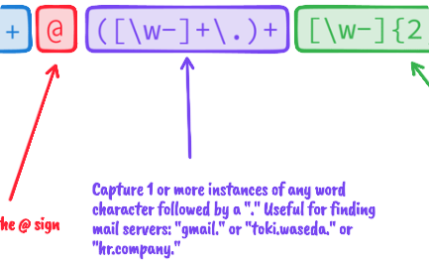
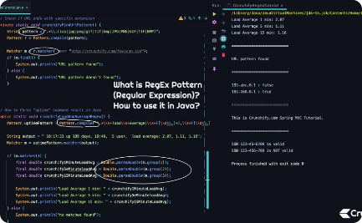
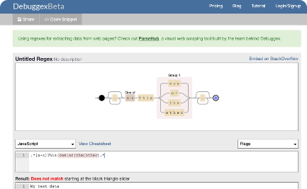
Regular Expressions for Pattern Matching in Strings
What are Regular Expressions?
How to Use Regular Expressions in Python
Regex Syntax
Regex syntax can be complex, but it follows a few basic rules. For example, the dot (.) character matches any character except a newline.
Regular expressions (regex) are a powerful tool for pattern matching in strings. They are widely used in data cleaning and data analysis.
Python has a built-in module for regular expressions called re. You can use it to search, match, and replace patterns in strings.

Slide 8

Conclusion and Summary of Key Points
1
Python strings are powerful and flexible.
2
Basic operations and string slices are key components of string manipulation in Python.
They can be used for everything from data analysis to web scraping.
They can be used to extract and manipulate data with ease.
3
String methods such as strip(), split(), and join() make working with strings more efficient.
4
Regular expressions are a powerful tool for pattern matching in strings.
They can be used to extract, clean, and manipulate data on a large scale.
They can speed up your workflow and reduce errors.

